Slide 1
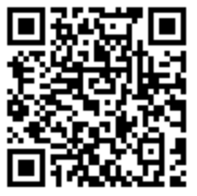
Tidyverse Workshop
Don’t forget to
Sign-In!
https://go.osu.edu/tidyverse

Slide 2
Agenda
What is Tidyverse?
Key Takeaways
Data

Slide 3
Before We Start…
Download R!
R https://cloud.r-project.org/
RStudio https://www.rstudio.com/products/rstudio/download/
Github Repository
https://github.com/kenbraggs/Tidyverse-Workshop/

Slide 4
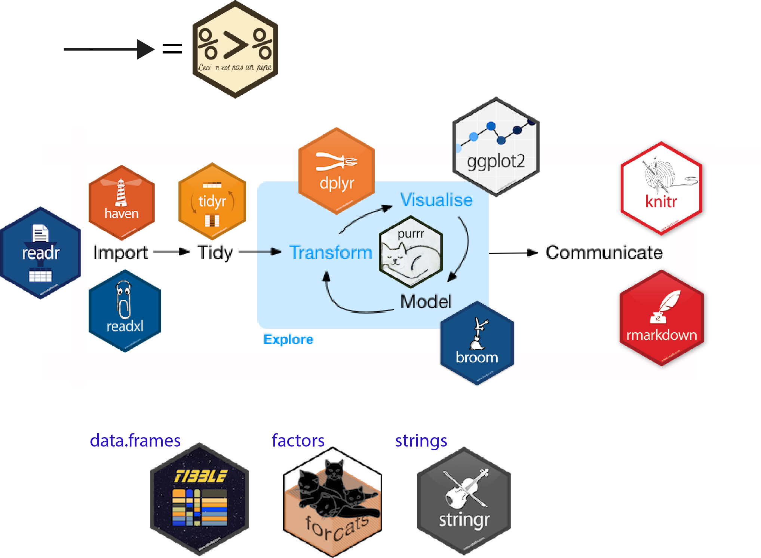
What is Tidverse?
Tidyverse is a collection of R packages used in conjunction for data science.

Slide 5
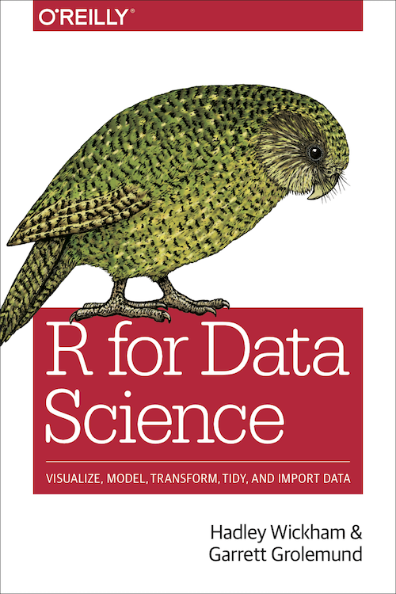
Where Can You Learn More?
Written in part by Hadley Wickham, Chief Scientist at R
Instructional book on how to use Tidyverse package
You can find this book here: http://r4ds.had.co.nz/

Slide 6
What Should You Takeaway?
Data Manipulation
%>%
Filter
Group_by
Summarize
Rename
Select
Mutate
Data Visualization
GGPlot
Plotly
https://gph.is/2gtQVhW

Slide 7
About the Data Set
Franklin County Car Crash Data
Found Here: https://ckan.smartcolumbusos.com/dataset/crash-data-for-franklin-county-2014-2016
https://gph.is/1F5CqnK

